Slide 1
Living History
A Mobile App to explore preserved historic buildings and locations in the city of Zurich

Slide 2

Outlook
Current Status
Schedule
Completed Steps
Demonstration of the App
Remaining Tasks
Challenges
http://blog.thoughtpick.com

Slide 3

Current Status - Accomplishment
Design Tours
Prepare Start Screen
Refinement of OGD
Started with GUI design
Started with App design
App Functionalities
Location
App Testing
Alpha Testing
Intermediate Presentation
http://cliparts.co/

Slide 4
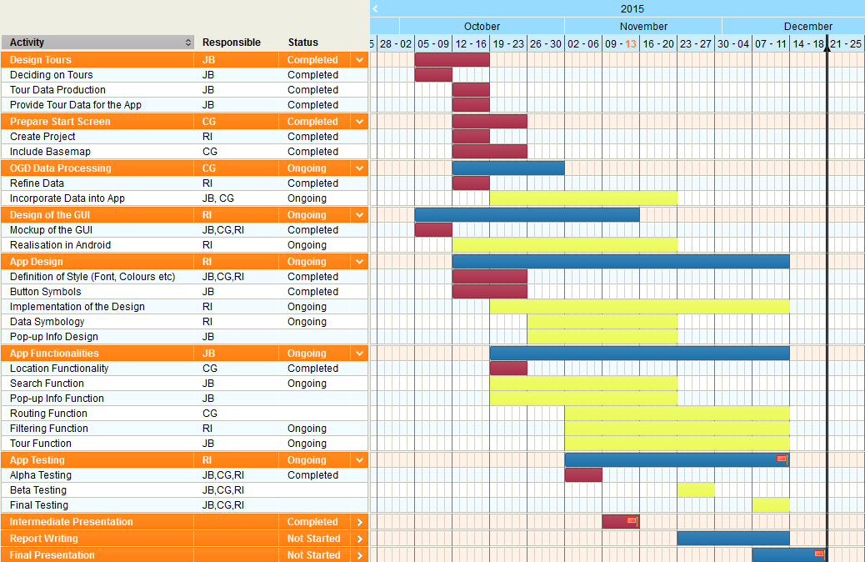
Schedule
Notes:
https://www.tomsplanner.com/?template=new#doc=AzLhKgZYPWlONJFgLPOz

Slide 5
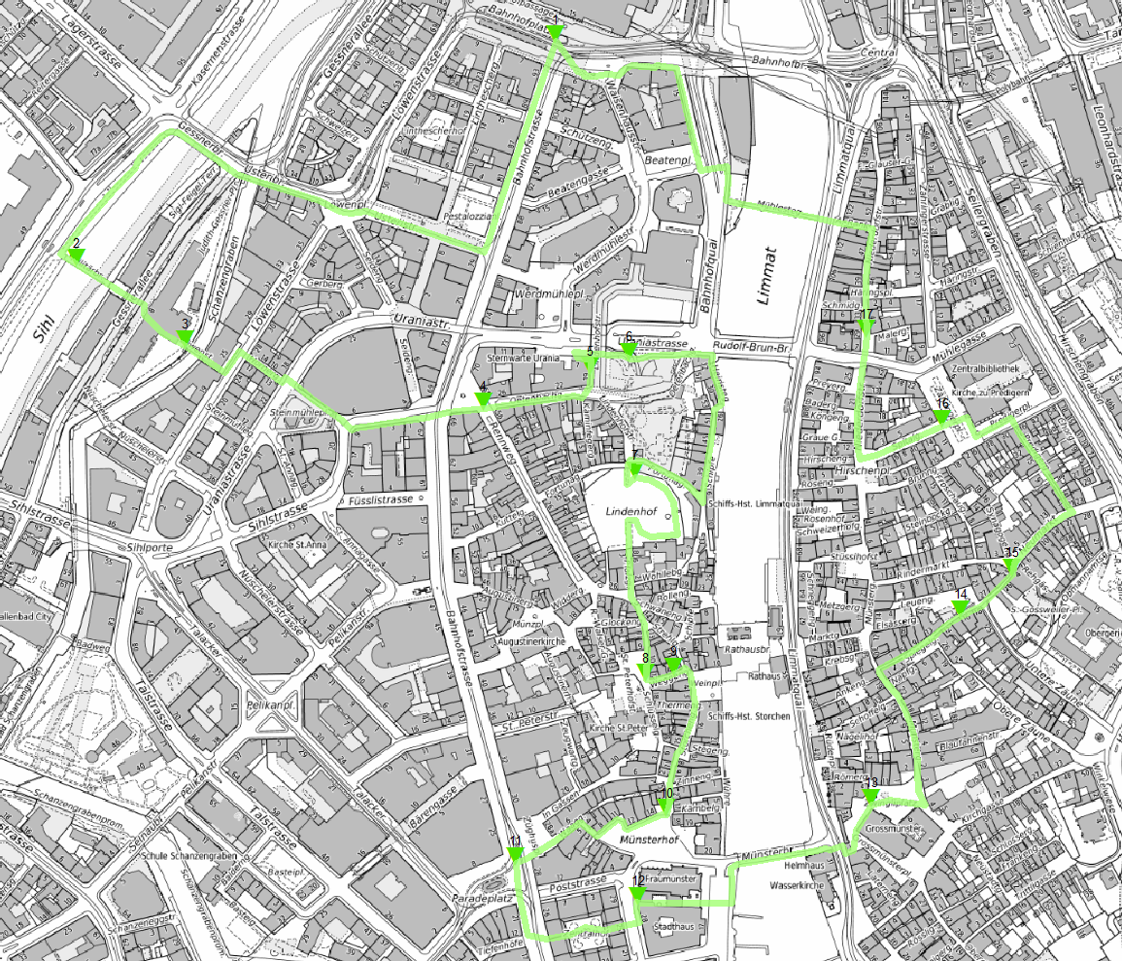
Tours

Slide 6

OGD Data
Refined it
ArcGIS Online
http://www.webmapsolutions.com

Slide 7
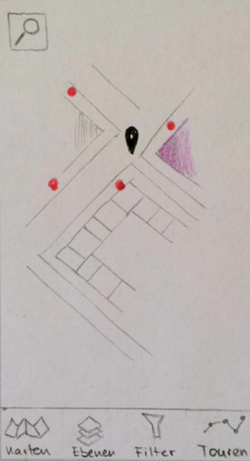
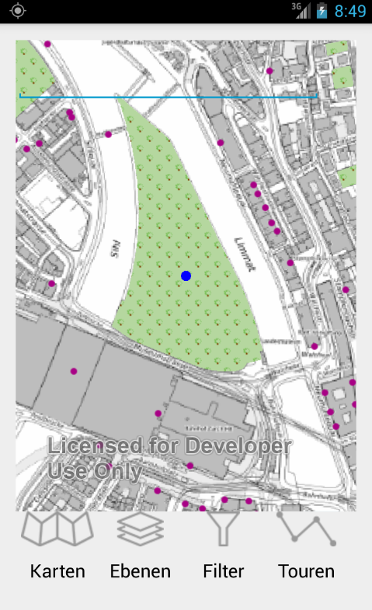
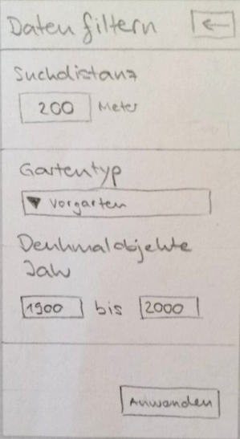
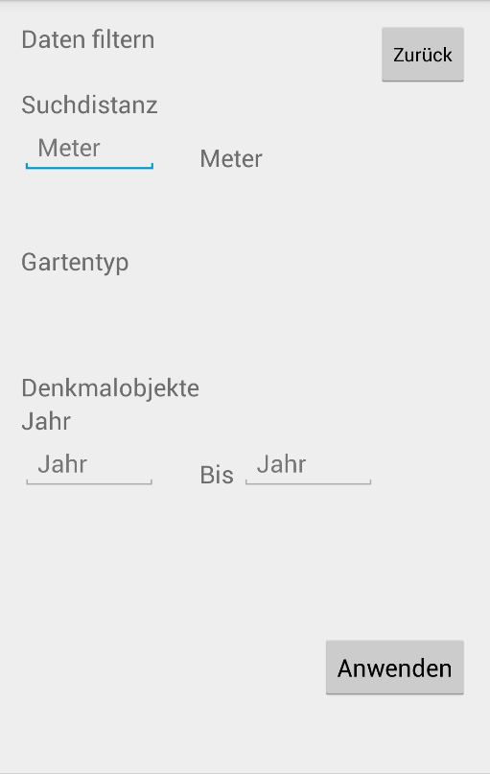
GUI and App design

Slide 8
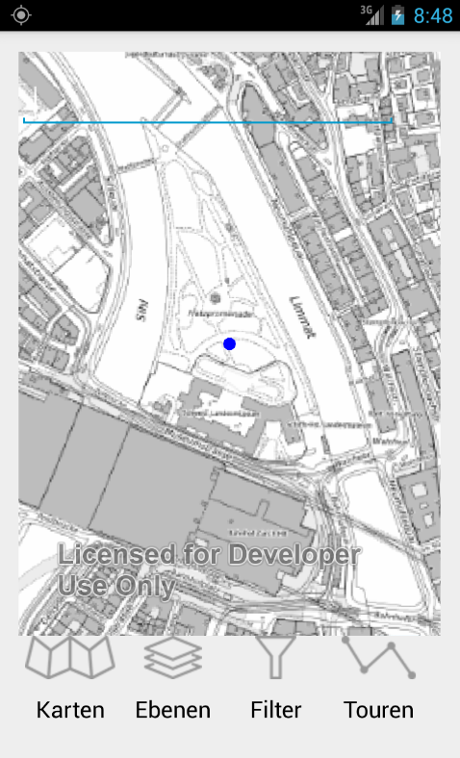
Location

Slide 9
Demonstration
Notes:
Picture for the Tours and some Description (Touren-Activitiy)
Line and Triangle showing for the Tours

Slide 10
Remaining Tasks
Incorporating OGD Data
Final Design of the GUI
Final App Design
App Functionalities
Search
Pop-up
Routing
Filtering
Tours
App Testing
Report
Final Presentation

Slide 11
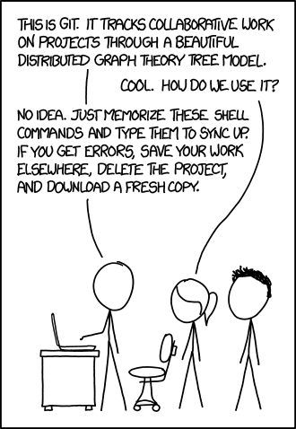
Challenges
Technical Problems
GitExtensions and Bitbucket
Android Studio → Gradle
Accessing WFS
Search with autocomplete
Time
http://xkcd.com/1597/

